Slide 1
应用安全之源代码安全审计
张东英 中国区Fortify产品经理
HP Enterprise Security Products
Notes:
Hi, my name is [Name]. I work as a [Title/ Role] at HP, in the Enterprise Security Products business unit. Today, I’ll be talking about application security and why governments and modern enterprises need it. What is application security? Simply put, it is about ensuring that every single line of code is secure and every single software application– whether it is built for the desktop, cloud or mobile device— is safe from cyber attackers and hackers. The goal here is about eliminating exploitable security risk in software at the application code level, making it immune to attack even if intruders get past perimeter defenses.

Slide 2

本课件由微信公众号“IT大会”发布 想要获得更多课件，听讲师现场讲解课程 敬请关注 “IT大会”

Slide 3

应用安全的现状
Notes:
Why is there a problem, and why do you need application security?
Like all organizations, you’ve undoubtedly, invested a lot of time and money attempting to insulate and protect your assets.
Your networks are protected – firewalls are in nearly every devices that connects to a network.
Your servers are protected, thanks to advances in intrusion prevention systems.
But your software applications are still largely unprotected and vulnerable.
Companies believed that if you protect the perimeter (network and server), the software will be unreachable and therefore not breachable. However, that has not proven to be the case: software is the New Entry Point.
Let’s take a look at how…

Slide 4
近期中国主要的应用安全事件
2014年3-5月，携程“安全门”事件，乌云漏洞平台指出携程网安全支付日志存在漏洞，导致大量用户银行卡信息泄露。小米论坛存在用户资料泄露
2014年4月，全球互联网遭遇多起重大漏洞攻击事件袭击：OpenSSL的Heartbleed（心脏出血）漏洞、IE的0Day漏洞、Struts漏洞、Flash漏洞、Linux内核漏洞、Synaptics触摸板驱动漏洞等重要漏洞被相继发现。
2014年11月到12月，针对索尼影业的持续渗透攻击，导致未发布的影片泄露、高管薪酬曝光，演员隐私信息被暴露等。
2015年6月美国互联网安全公司白帽子安全实验室《2015网站安全统计报告》：86%的WEB网站至少有一处严重的应用安全漏洞，而且大多数时候不止一个。
Notes:
Fortify Update - November 2009 - CIOSEBofD October 22, 2008 - CEO Update
Fortify Proprietary & ConfidentialFortify Proprietary and Confidential
4
A SQL Injection vulnerability is an easy to find, easy to fix bug in code. This should never have happened….
BofD October 22, 2008 - CEO Update
Fortify Proprietary and Confidential
4

Slide 5











应用软件成了目前黑客发起攻击的突破口
应用
硬件及系统
网络
Security Measures
Switch/Router security
Firewalls
NIPS/NIDS
VPN
Net-Forensics
Anti-Virus/Anti-Spam
DLP
Host FW
Host IPS/IDS
Vuln. Assessment tools
知识产权
客户数据
业务流程
商业机密
Notes:
In today’s information-centric world, Hackers are after data and business logic, which they can manipulate and control. You’re talking about stealing your Intellectual Property, your Customer Data (credit card, SSN, address, etc.), Business Processes and Trade Secrets.
With software, protecting one point in the system is not sufficient. The whole pathway to the data must be secure. If there is any vulnerability along that path, then the entire system is vulnerable. Hackers are ingenious in discovering new pathways. Years ago, they started at the network and hardware levels, but we have been successful in handling the problem (grayed out area), now they are going right to the app layer.
This can be useful in explaining things like why encryption is not going to help you with app sec.
5

Slide 6
84%
的攻击是利用了应用软件的漏洞
Notes:
As an industry we have become much more effective at protection at the network and operating systems level. But as we see in the data, that now 84% of breaches take advantage of vulnerabilities in the applications.
This tells us that our adversaries are innovating. When you combine this with the increased leverage of attack tools like Zeus, or the favorite of Anonymous, Low Orbit Ion Canon or LOIC. Something different is going on and we need to pay attention to these changes if we are going to improve our success rate.
Let’s face it folks, at this point in time the adversaries are clearly winning.

Slide 7
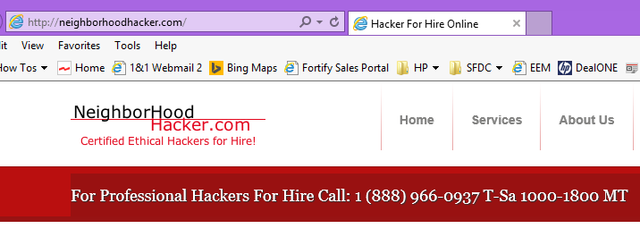
攻击者是从哪里来的？
Notes:
Fortify Update - November 2009 - CIOSEBofD October 22, 2008 - CEO Update
Fortify Proprietary & ConfidentialFortify Proprietary and Confidential
7
A SQL Injection vulnerability is an easy to find, easy to fix bug in code. This should never have happened….
BofD October 22, 2008 - CEO Update
Fortify Proprietary and Confidential
7

Slide 8
用户采购的驱动力
国家
1、信息安全等级保护
2、ISO27001
电信
1、进一步强化开发测试系统及合作伙伴人员安全管理的通知
2、中国移动第三方管理办法
3、工信部关于加强电信和互联网行业网络安全工作的368号文
金融
1、 PCI DSS支付卡行业数据安全标准
2、网上银行系统信息安全通用规范
3、电子银行业务管理办法及电子银行安全评估指引
其他
1、 保监会2014年加强网站系统安全防范工作的紧急通报
2、国家电网信通〔2014〕138号_国家电网公司关于印发2014年信息化建设实施意见的通知
8
Notes:
LISTEN: I do not have budget for this year, the economy is bad, and more cuts are coming. It doesn't make sense to take time to meet
CLARIFY: What projects do you have budget for right now?
As budget cuts increase, are more people getting laid off as well?
RESPOND: Protecting confidential information from leaving the organization is especially crucial during bad times. The risk of people leaving the organization with your confidential information is especially high. For many of our customers, once they see the risk and potential liability, budget typically follows. We can help you justify budget for this solution by proactively identifying threats to your data before it becomes a major liability and costs you lots of money.
CLOSE: So, was that helpful? Do you have any additional concerns?

Slide 9
企业主要面临的挑战
Notes:
Why is there a problem, and why do you need application security?
Like all organizations, you’ve undoubtedly, invested a lot of time and money attempting to insulate and protect your assets.
Your networks are protected – firewalls are in nearly every devices that connects to a network.
Your servers are protected, thanks to advances in intrusion prevention systems.
But your software applications are still largely unprotected and vulnerable.
Companies believed that if you protect the perimeter (network and server), the software will be unreachable and therefore not breachable. However, that has not proven to be the case: software is the New Entry Point.
Let’s take a look at how…

Slide 10




软件安全测试的挑战
软件测试现状:
在预算内准时完成 - 功能测试与性能测试
资讯安全专家不懂软件开发
软件开发人员
品保人员
不懂软件安全知识
代沟
要搭起安全测试整合桥梁

Slide 11
修复漏洞的成本
Runtime
在产品上线阶段修复漏洞的成本多花费超过30倍
WebInspect
30X
Fortify SCA
15X
成本
Education
10X
5X
2X
需求分析
编码
集成/ 单元测试
系统测试
系统上线
Source: NIST
Notes:
According to an NIST study, the cost of fixing software increases substantially further along the Software Development Lifecycle (SDL). It costs 30x more to fix security issues after a breach in Production than to build security into your code at the beginning during an applications Design.
The Fortify software aims to cover each stage of the SDL - from educating developers up front, to dynamic analysis to assist with an applications QA, and finally to runtime protection of applications in Production.
We’ll be focusing on securing applications in development. How to get the most out of SCA to ensure vluns are found and fixed early “saving both time and money”.

Slide 12

解决之道

Slide 13








一、HP Fortify Static Code Analyzer (SCA)
清除软件中的各种漏洞地雷
SQL 注入
XSS 跨网站脚本攻击
人工安全测试
自动化安全测试产品

Slide 14
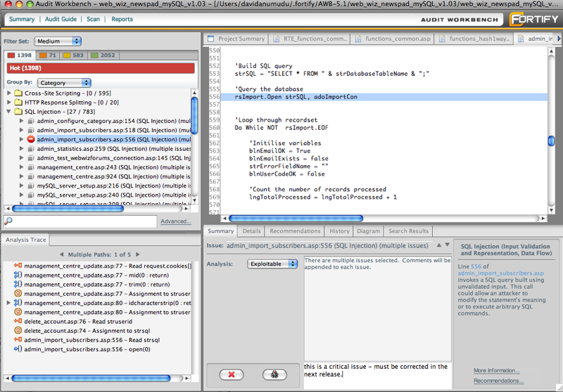
Fortify Static Code Analyzer (SCA)
静态分析– 发现和修复源代码的安全隐患
用户场景：
用户拥有开发团队，拥有源代码
特征:
静态应用程序安全性测试，自动化识别在开发期间应用程序源代码的安全漏洞和质量问题
查明源代码漏洞的根本原因，提供详尽的修复指导
支持22种语言,600 +漏洞类别
ABAP、ASP.NET、C,C++、C#、Classic ASP、COBOL、ColdFusion、Flex/ActionScript、Java、JavaScript/AJAX、JSP、Objective C、PL/SQL、PHP、Python、T-SQL、VB.NET、VBScript、VB6、XML/HTML、Ruby
优势:
拥有最大的市场份额和最高的用户口碑
支持最多的开发语言，操作系统
发现的安全漏洞有无与伦比的准确性和全面性
拥有业界最庞大最权威的代码漏洞规则库
拥有强大集成功能，整合开发流程测试流程
Notes:
Cross-Tier Analysis
Custom Analysis Algorithms
Data flow - Input validation
Control flow - Unreleased Resources
Content - Embedded logic
Configuration - Framework configuration
Structural - Coding policy violations
21 languages
500+ vulnerability categories

Slide 15
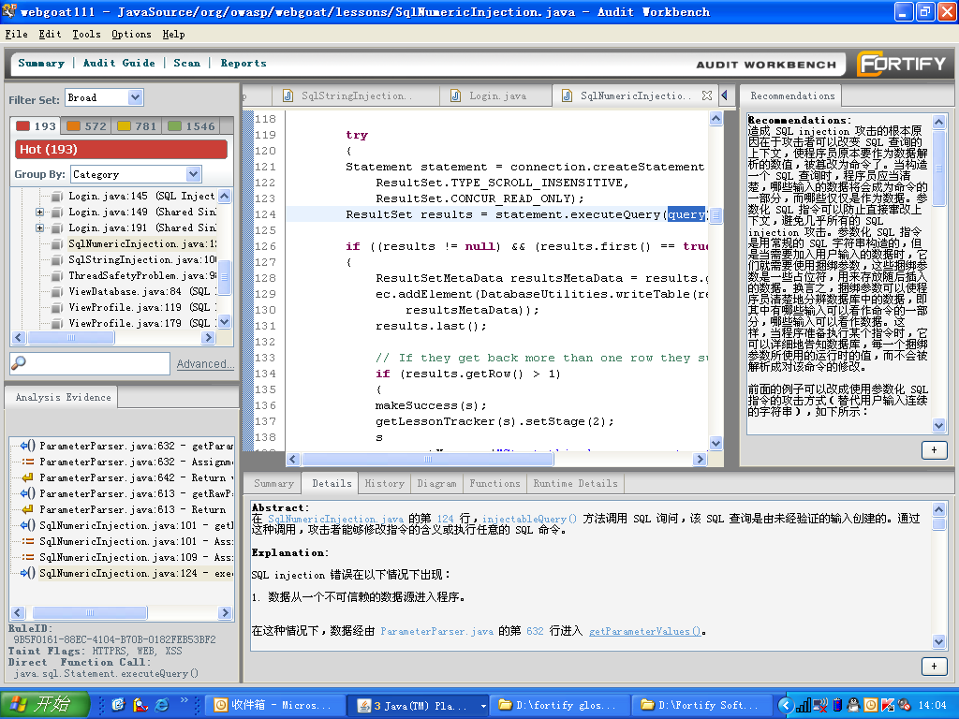
Fortify SCA漏洞审计---Audit Workbench
漏洞推荐修复的方法
分级报告漏洞的信息
项目的源代码
漏洞产生的全路径的跟踪信息
漏洞的详细说明
Notes:
这个就是Fortify SCA最后产生出来的结果的呈现，大家可以看到：
首先，Fortify SCA 将分析出来的漏洞进行分级，左上角可以看到HOT， Warning, Info 三个级别，HOT，就是热点问题，比较严重的，Warning，警告级问题，次严重，Info，信息级问题，不太严重或质量方面的问题。 这样有利于对漏洞划分优先级来不同程度的处理。
点击其中的每一个漏洞，在左下角就可以看到这个漏洞产生的全过程，全路径，点击这个跟踪过程中的每一个节点就可以定位相应的源代码，这样可以很有利于我们对问题进行分析，审计，也利用于开发人员决定在什么地方对其进行修复。同时，这个跟踪过程还可以以类似于UML的图形化的形式展示，更加直观，逻辑更清楚，更具有说服力。
对于开始使用的人员，如果扫描出来的问题看不懂，不要紧，AUDIT 提供出漏洞的详细说明和解释，这个告诉你这个漏洞是什么意思，怎么产生这个漏洞，再举上一到两例子。
如果看懂了，不会修复怎么办？不要紧，AUIT也提供了漏洞没推荐的修复方法，供你参考。所以，SCA使用一段时间的以后，审计人员和开发人员的软件安全知识会有很大程序的提高。

Slide 16
二：Webinspect黑盒测试完成Web漏洞的动态分析
实时扫描仪表板
覆盖分析情况
实时扫描统计
攻击详情表格
发现的漏洞展示

Slide 17






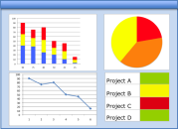

HP Fortify ---构建企业应用安全管理中心
静态分析SCA
动态分析Webinspect
实时在线分析RTA
源代码
黑客
集成构建
应用程序运行在QA/生产环境
在运行系统的实时保护
漏洞管理
(静态, 动态, 实时)
标准化
(计分卡、指南)
应用安全修复
HP SSC应用软件安全管理中心
相关的目标漏洞
源代码漏洞库
风险降低的衡量标准
关联分析
(静态、动态、实时)
基于威胁驱动的中央管控
所有相关人员
安全& 开发人员
Notes:
The Fortify Runtime solution leverages and enhances the logic in your software to accurately identify as well as mitigate malicious behavior. It also provides user behavior and transactional logging for security analysis. Fortify Runtime has the unique capability to accurately monitor and protect applications that are in
production—augmenting solutions you might already be using in other parts of the software development lifecycle (SDLC). Fortify Runtime protects your users, your applications as well as data, stops you from losing data, and helps detect fraudulent behavior.
The solution works inside the application—it works directly with the application binary offering security monitoring and protection without source code or additional hardware. This unique approach has numerous benefits. It’s easy to get Fortify Runtime up and running; it protects every entry point; it doesn’t require re-programming or re-learning when the application is updated and it has access to the business logic and key program data of the application, making it extremely accurate. In addition, it allows a user to quickly apply company-specific rules into any application in order to combat fraud and other logic-based threats. Operations, information security, or developers can easily leverage the Fortify Runtime to embed security into their applications.
Fortify Runtime is a software solution for Java- and .NET-based applications that works inside an application to actively monitor and protect against directed attacks as well as other potential threats posed against an application and the data behind it. The solution automatically identifies security critical code inside the application and actively monitors these locations. As applications are running, it detects security events, mitigates attacks, and can log monitored events to HP Fortify Software Security Center, HP ArcSight Logger or ESM, and the file system.
When configured for application protection, Fortify Runtime responds to attacks in a variety of ways, including blocking the user entirely, logging the user out, stopping the request, sanitizing the request or alerting a key administrator—delivering a unique approach to protecting Web applications. At any point in time, you can see who is attacking (based on IP address, domain name, and more), how the attack is being conducted, and what part of the application is being attacked, down to the exact line of code.

Slide 18
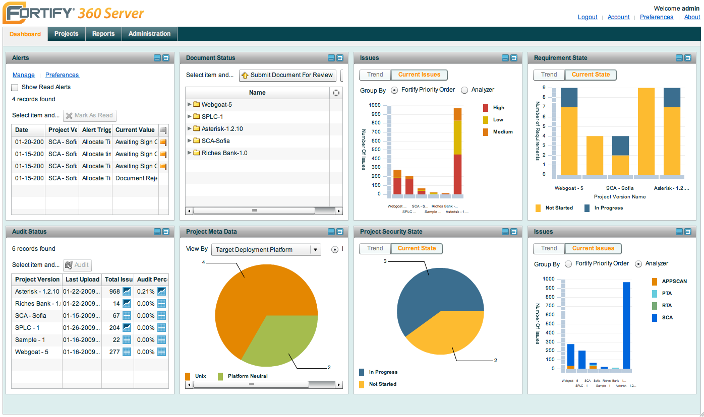
统一管理平台：Fortify Security Center
Notes:
首先，360 SERVER 主要分为四个模块。 Dashbaord, projects, report, administration.
我们可以看到Dashbaord模块，顾名思义，它就像汽车上的仪表盘一样，是一个项目当前综合信息集中展现的模块。它通过多个小的子窗口，从多个方面来集中展现当前各个项目的各项信息。让管理人员对所管理的项目的状况一目了然。
这六个子模块包括：预警通知， 项目安全状态，问题趋势，问题审查状况，文档态状态以及项目各项需求状况。

Slide 19
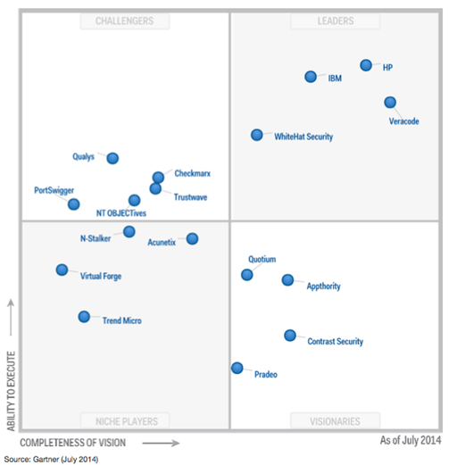
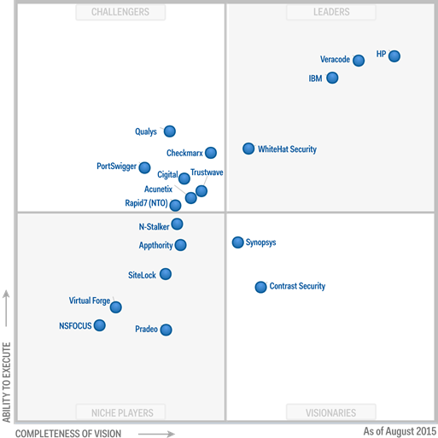
2014-2015年国际权威机构最新排名

Slide 20
案例分享
Notes:
Why is there a problem, and why do you need application security?
Like all organizations, you’ve undoubtedly, invested a lot of time and money attempting to insulate and protect your assets.
Your networks are protected – firewalls are in nearly every devices that connects to a network.
Your servers are protected, thanks to advances in intrusion prevention systems.
But your software applications are still largely unprotected and vulnerable.
Companies believed that if you protect the perimeter (network and server), the software will be unreachable and therefore not breachable. However, that has not proven to be the case: software is the New Entry Point.
Let’s take a look at how…

Slide 21


































































































































































银行及金融
基础软件厂商
电信
其它
政府机构
电子商务
医疗及保健

Slide 22





















































国内主要用户

Slide 23
Case Study---天津银行
HP Fortify提升软件质量确保天津银行为用户提供安全的金融产品
目标
惠普解决方案及服务
成效
天津银行要在有限的人员投入下保证系统质量、快速交付应用服务，纯手工人工非自动化的方式已然不能适应业务的快速变化，所以亟需要采用专业的自动化测试工具，通过一组全面规则、测试机制在软件开发、测试过程中发现和管理软件的安全隐患，进而提升审核效率
HP Fortify在业界拥有很好的用户口碑，国内许多金融企业也广为应用这款产品进行软件安全测试。HP Fortify是一个静态的软件源代码安全测试工具，拥有最全面的安全代码规则包，支持市场上最流行、最多样化的编程语言，安全漏洞检查也最为彻底。成熟领先的产品、丰富的实施经验、专业的服务团队让天津银行锁定惠普
对源代码进行安全漏洞扫描时省时省力
代码审核更规范、更精确，提升代码审核效率
Notes:
天津银行
天津银行成立于1996年11月，原名天津城市合作银行，时为中国首批获准组建的5家城市合作银行之一，是一家由天津市国有股份、中资法人股份、外资股份及众多个人股份共同组成的股份制商业银行，1998年8月和2007年4月，天津城市合作银行先后更名为天津市商业银行和天津银行，目前注册资本为15.5亿元人民币。已在北京、唐山、上海设有分行。 澳紐銀行（ANZ）持有20％股權。
目标
天津银行要在有限的人员投入下保证系统质量、快速交付应用服务，纯手工人工非自动化的方式已然不能适应业务的快速变化，所以亟需要采用专业的自动化测试工具，通过一组全面规则、测试机制在软件开发、测试过程中发现和管理软件的安全隐患，进而提升审核效率
方法
HP Fortify在业界拥有很好的用户口碑，国内许多金融企业也广为应用这款产品进行软件安全测试。HP Fortify是一个静态的软件源代码安全测试工具，拥有最全面的安全代码规则包，支持市场上最流行、最多样化的编程语言，安全漏洞检查也最为彻底。成熟领先的产品、丰富的实施经验、专业的服务团队让天津银行锁定惠普
IT 增益
• 对源代码进行安全漏洞扫描时省时省力
• 从整个代码中轻松找出安全问题，及时修正漏洞
业务成效
• 代码审核更规范、更精确，提升代码审核效率
• 满足上级监管要求
• 确保软件质量，降低企业风险
客户解决方案概览
软件产品
• HP Fortify

Slide 24

“通过人工方式进行代码审核，存在标准不统一、源代码扫描不规范、细小错误不能发现等问题，软件即使审计通过上线了，在实际运行过程中风险依然非常大。采用成熟的代码检测工具来进一步完善系统测试流程，能够消除代码潜在的风险，提高代码的质量、可读性和可维护性，保护银行的应用。” – 天津银行信息科技部许平副总经理

Slide 25
Questions?

Slide 26

Thank you 张东英 Dongying.zhang@hp.com

